Slide 1


Sai Vidya Institute of Technology
(Affiliated to VTU,Belagavi,Recognized By Govt. of Karnataka
Approved by AICTE,New Delhi)
Accredited by NBA,New Delhi (CSE,ISE,ECE,MECH,CIVIL), NAAC - 'A' GRADE
Rajanukunte,Bengaluru - 560064
Pogil Activity (5th Sem) :- Application Development using Python
( 18CS52 )
Contact Book
Done By:-
Sahana A ( 1VA20IS039 )
Shamanth S ( 1VA20IS044 )

Slide 2
Description
A contact book is a handy tool to keep all your contacts in one place.
This python project will allow you to create a contact book and add, edit, and delete contacts.
In addition, you’ll be able to view all your contacts and their details in one place.
This project is perfect for anyone who wants to keep their contacts organized and accessible.

Slide 3
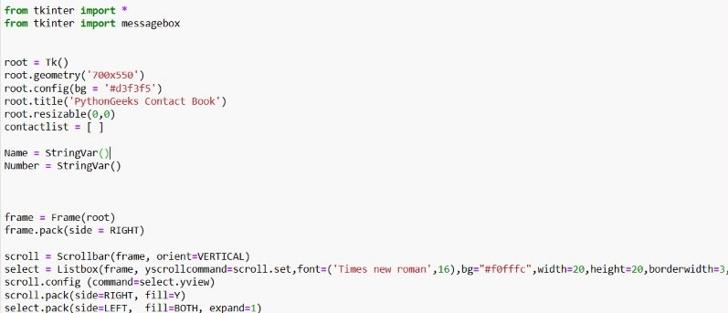
Source Code

Slide 4
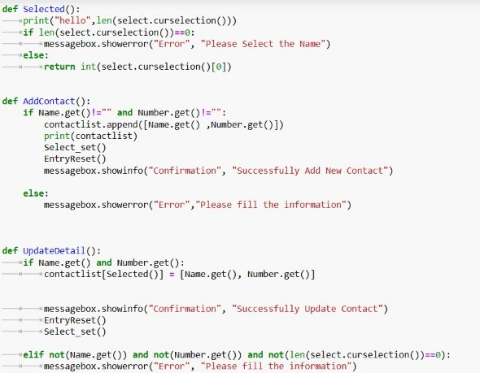

Slide 5
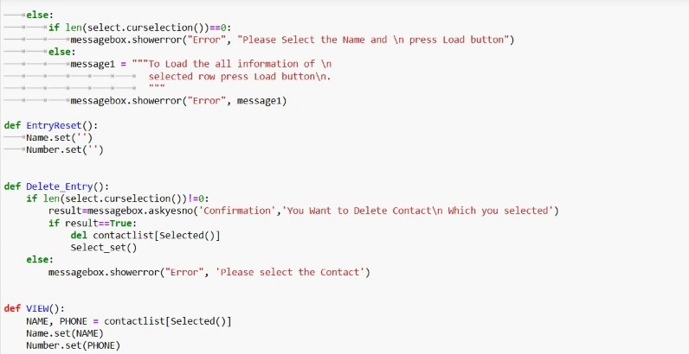

Slide 6
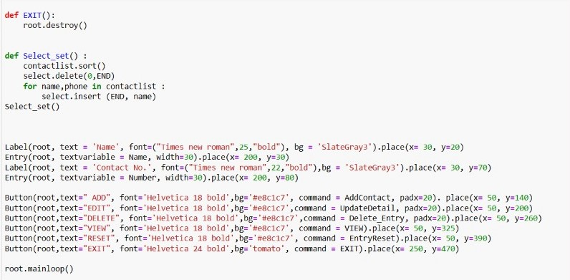

Slide 7
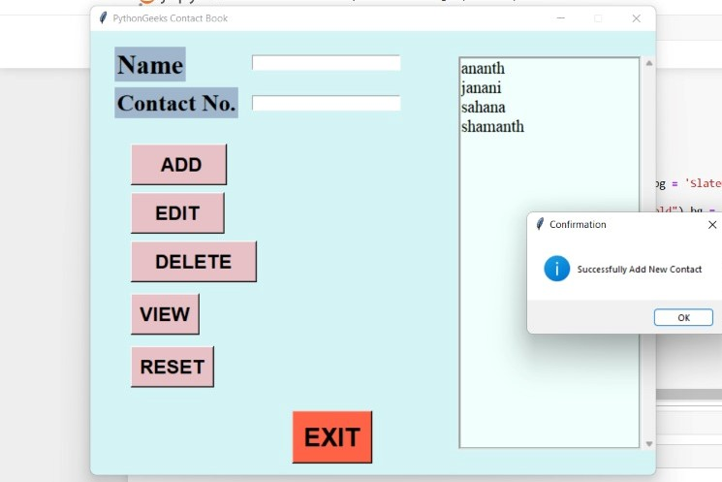
Output

Slide 8
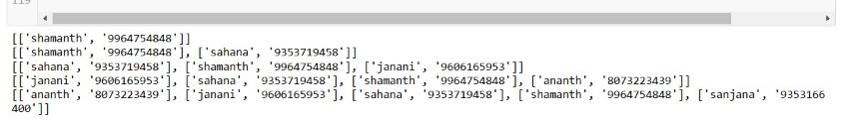

Slide 9
Thank you

